Slide 1
Flow Charts
Prepared by
Said Fawzy
Manager of Information Center-Quality Manager
Tendering Department Arab Contractors

Slide 2
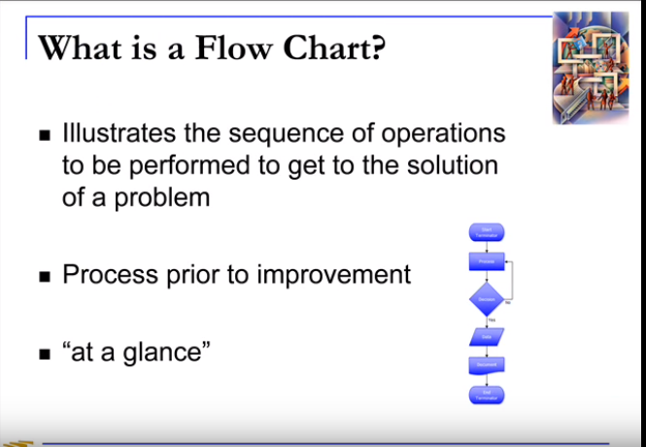

Slide 3
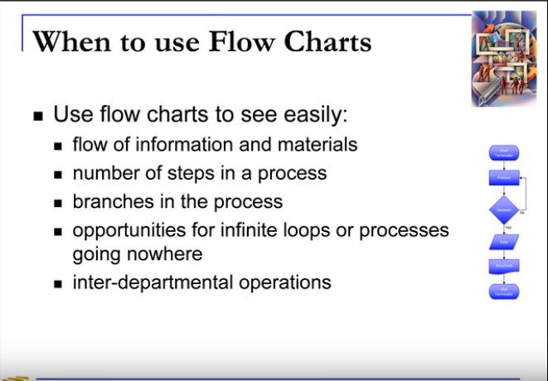

Slide 4
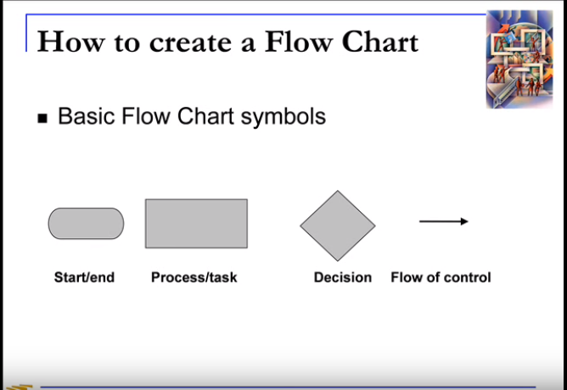

Slide 5
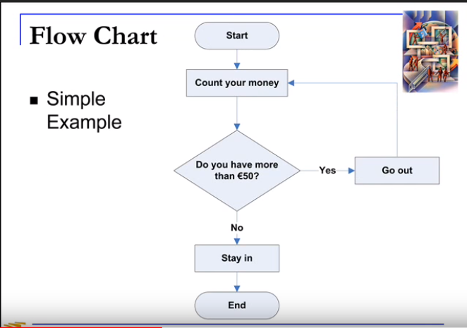

Slide 6
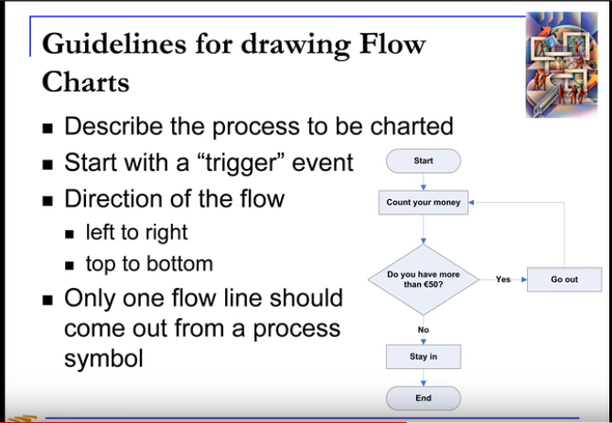

Slide 7
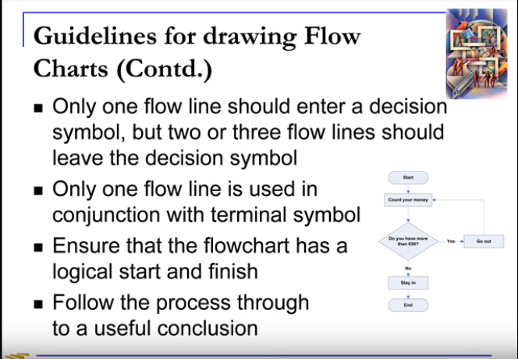

Slide 8
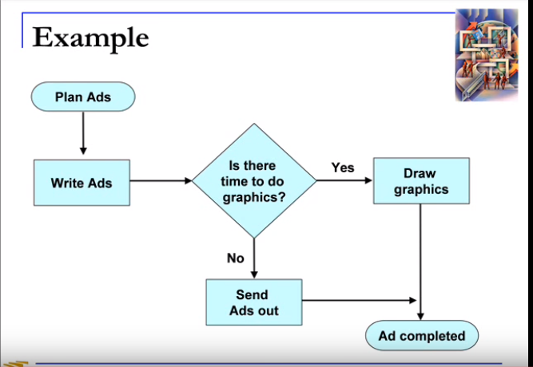

Slide 9
